Slide 1
Basics of CNN
Course Code: CSC 4254
Course Title: Computer Vision & Pattern Recognition
Dept. of Computer Science
Faculty of Science and Technology
Lecture No: | 8 | Week No: | 4 | Semester:
Lecturer:

Slide 2
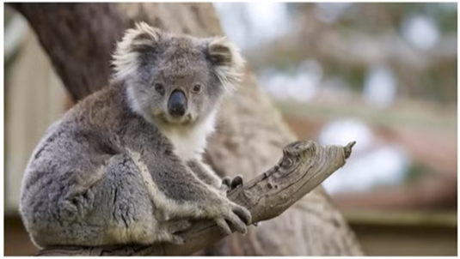
Problems in ANN
Image Size = 1920 x 1080 x 3
After Flattening =
622,080 ~ 6.2M
Hidden Layer Neuron =
4M
Total Weights=
6M x 4M = 24M
If it’s a deep NN of 100 hidden layers?
An RGB Image of Koala (Full HD)
2.4 Billion

Slide 3
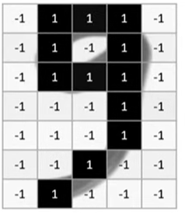
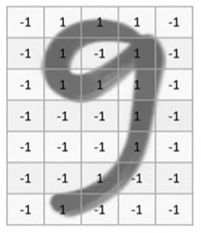
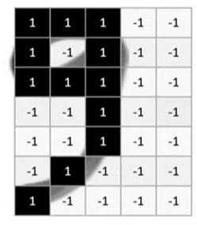
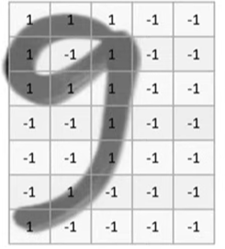
Problems in ANN
Machine Sees it as
Do they match?
NO
Same image just shifted 1 pixel left
Consider this

Slide 4


Problems in ANN
Too much input parameters/calculations
Images are sensitive to their training positions
Variety of same image can not be traced
Solution, Remember Hubel wiesel Study
How you see a thing? Or How cats see a thing?
A group of neuron were identifying a portion, then sent those to other neurons

Slide 5
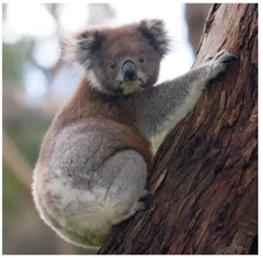


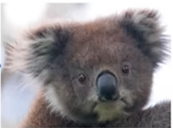

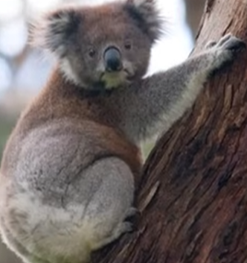
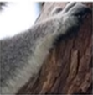
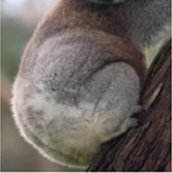
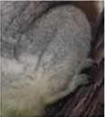
More on Human Perspective
Eyes
Head
Nose
Koala
Ears
Hand
Body
How did you identify it as a kaola?
Leg

Slide 6
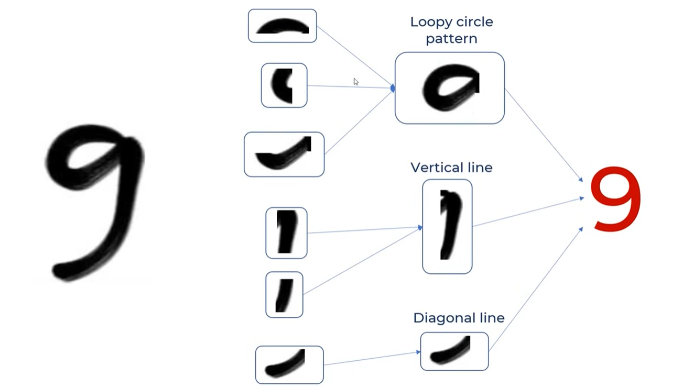
A Brief Picture of How CNN will Work

Slide 7
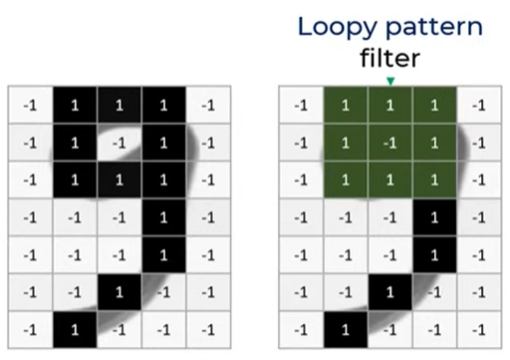
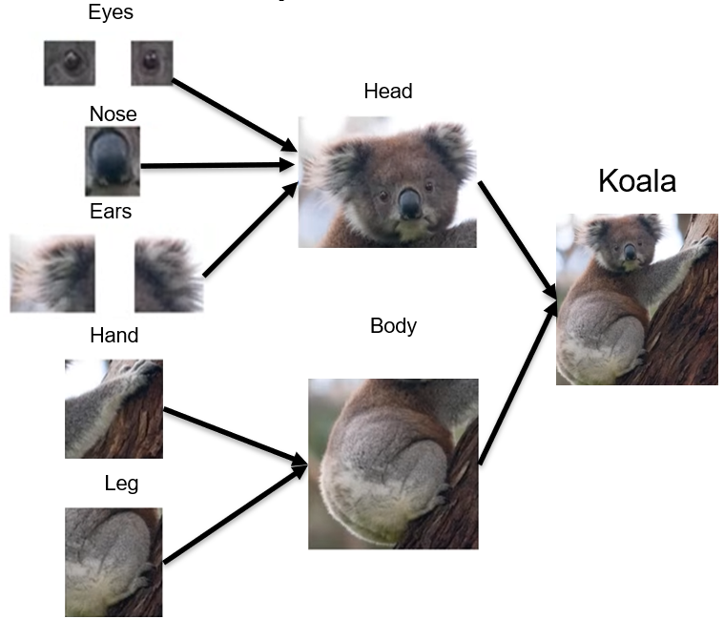
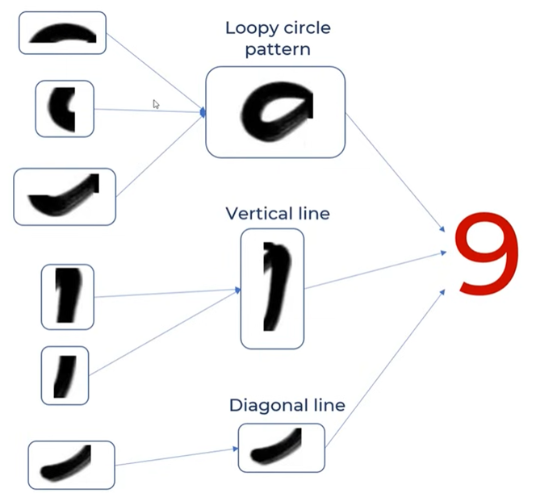
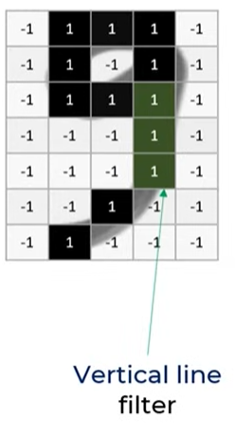
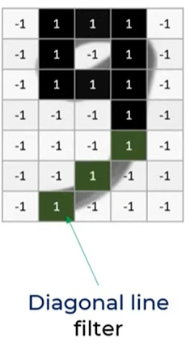
Building Blocks of CNN
Filters
Or Kernels:
A filter or kernel is a matrix of weights that is initialized randomly at the start. The model learns the optimal weight values of a filter over increasing epochs. It could be of 3x3, 5x5

Slide 8
How Filter Works

Slide 9
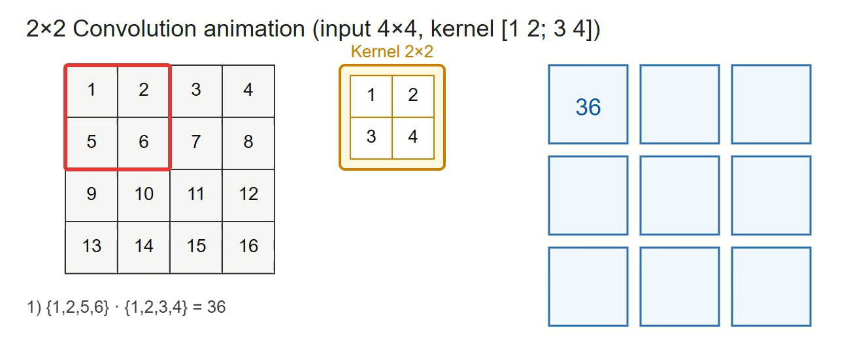
How Filter Works

Slide 10
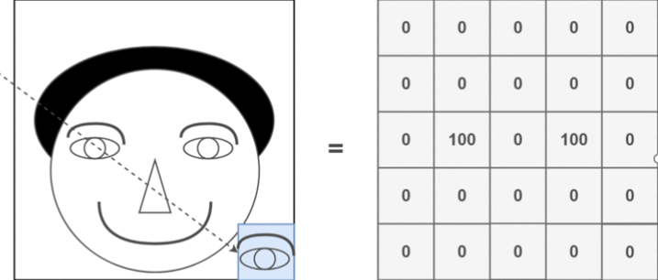
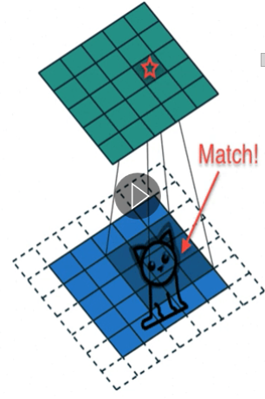
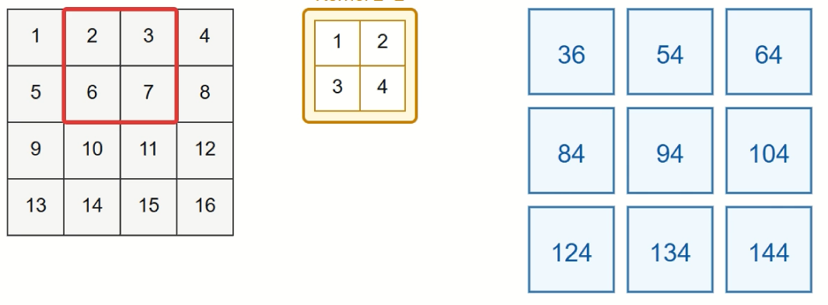
Feature Map
Feature Map
Feature Map
Kernel/Filter
Input

Slide 11
What Does Feature Map Do?
A feature map is the output of a convolution layer that captures and highlights specific patterns or features in the input image, such as edges, textures, or shapes. Each filter produces a feature map showing where and how strongly that feature appears, helping the network understand important visual details for tasks like classification or detection.
In Short: A feature map is the output of a convolution layer that highlights the locations of detected features in the input image.

Slide 12
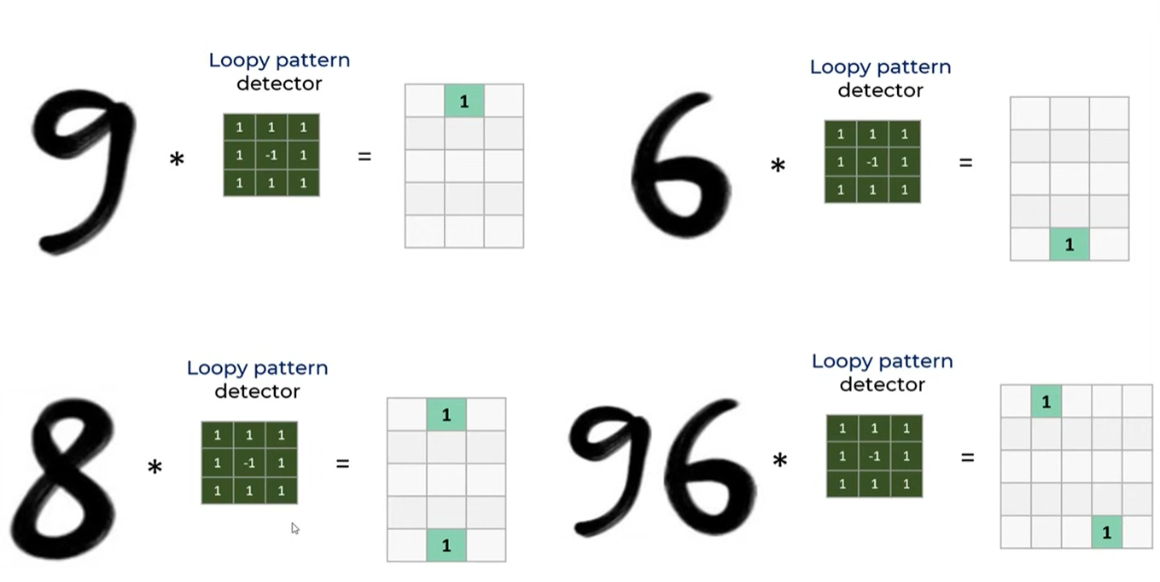
Feature Map Using Kernel/Filter

Slide 13
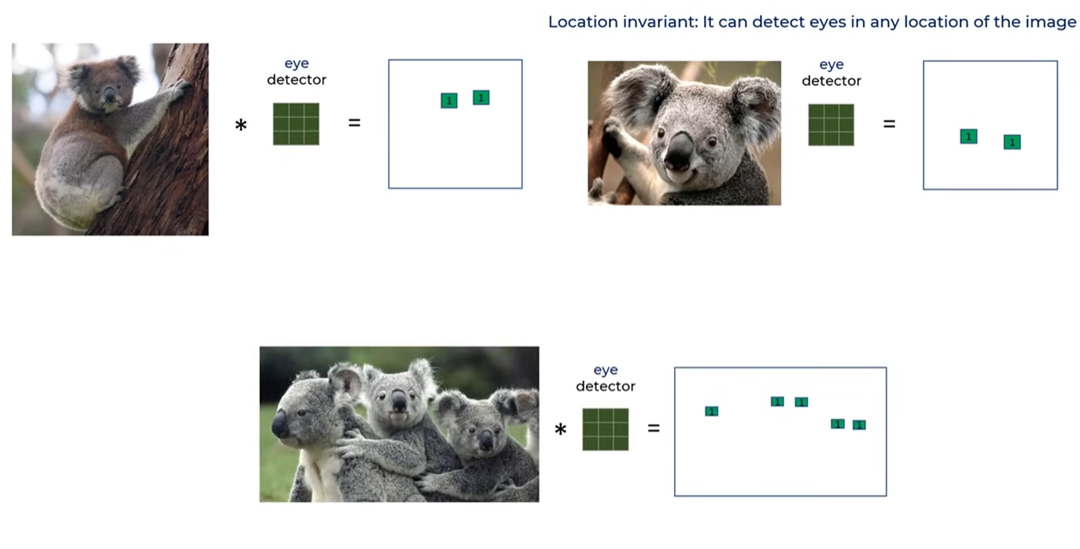
Feature Map Using Kernel/Filter

Slide 14
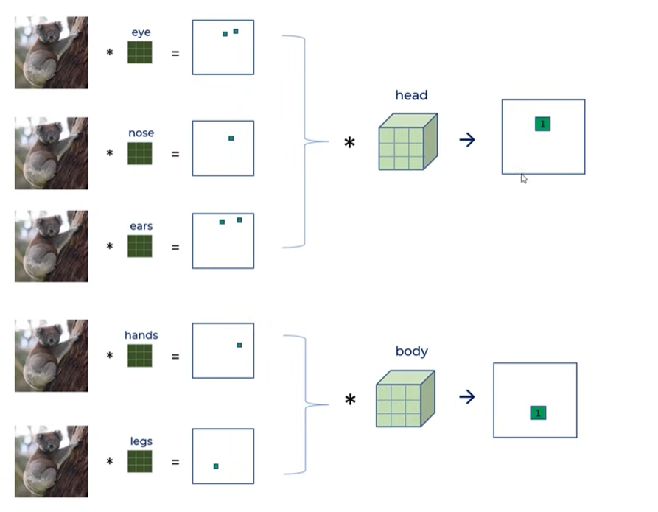
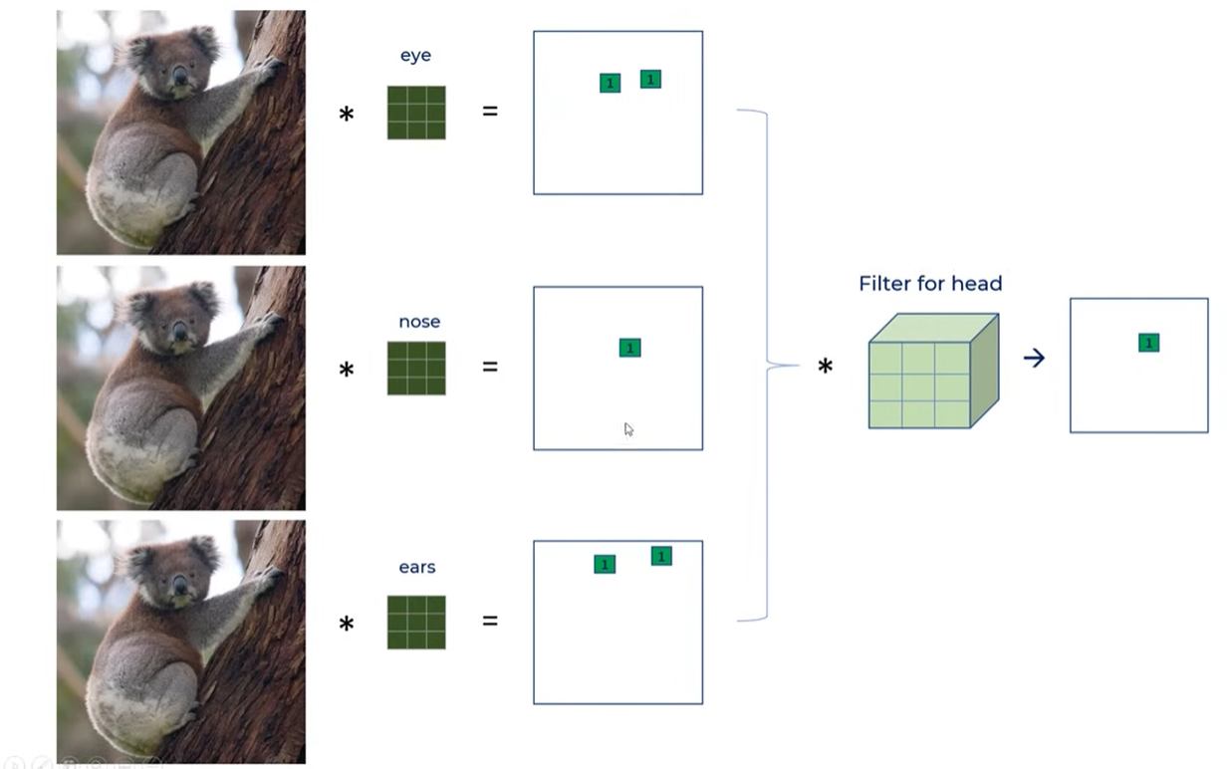
Feature Map Using Kernel/Filter

Slide 15
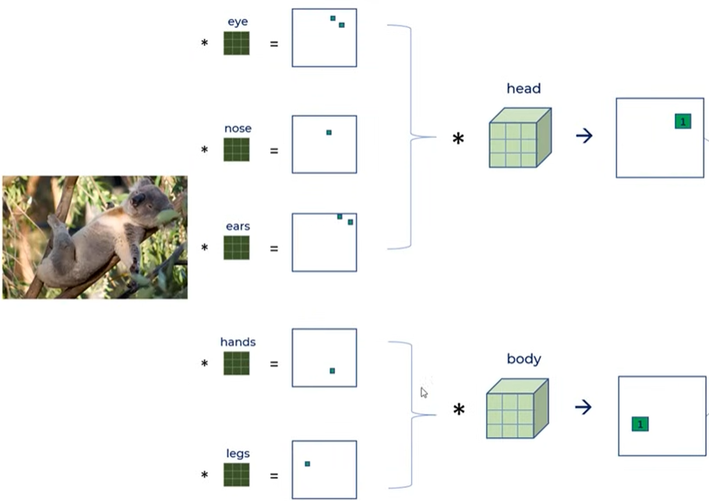
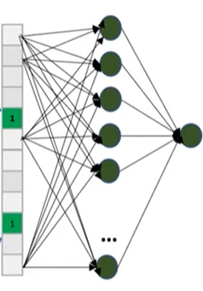
Overview CNN
Feature Extraction
Classification

Slide 16
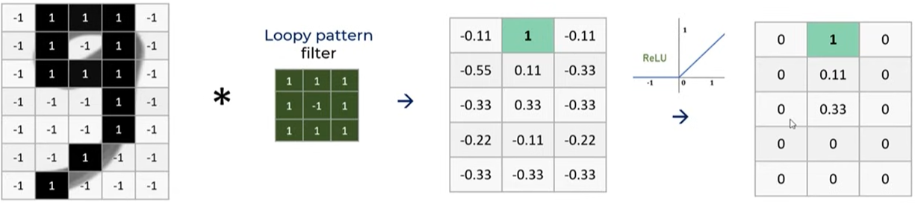
Activating the Feature Map with ReLU

Slide 17
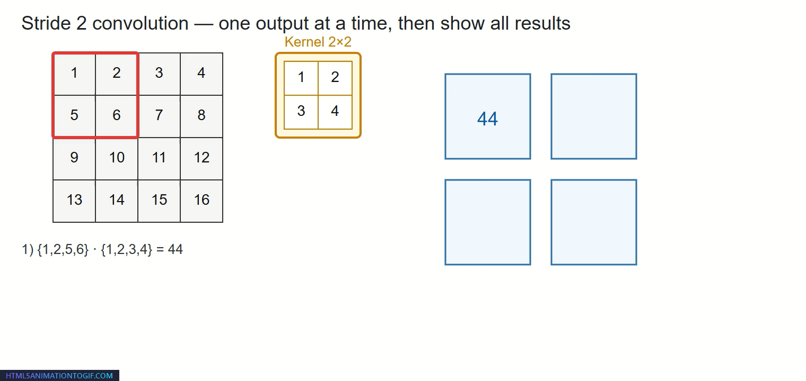
Strides
The number of pixels a filter moves across an image at each step during convolution. Stride controls how much the filter shifts each step — larger stride reduces output size, smaller stride preserves more detail.
Stride 1,1
Stride 2,2

Slide 18
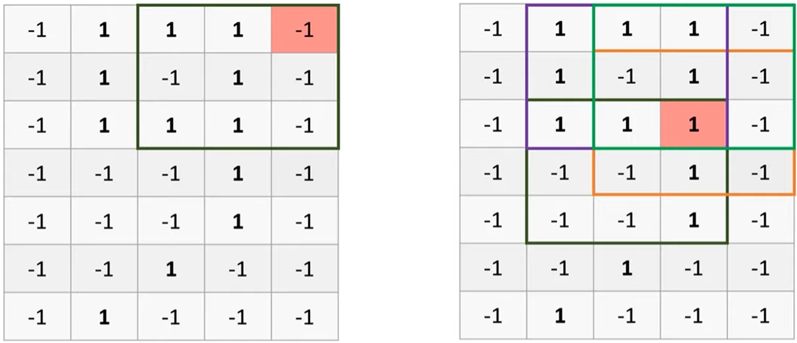
Padding
They are considered fewer that other pixels
This pixel is getting more attention

Slide 19
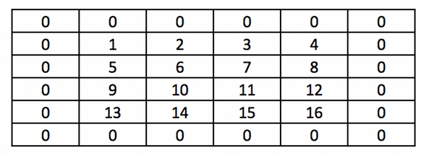
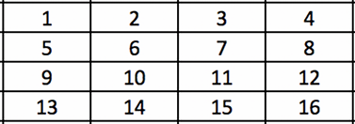
Padding
Adding extra pixels (usually zeros) around the input image to control output size and preserve edge information. Helps keep the output size the same and prevents loss of information at the borders.
Input Image

Slide 20
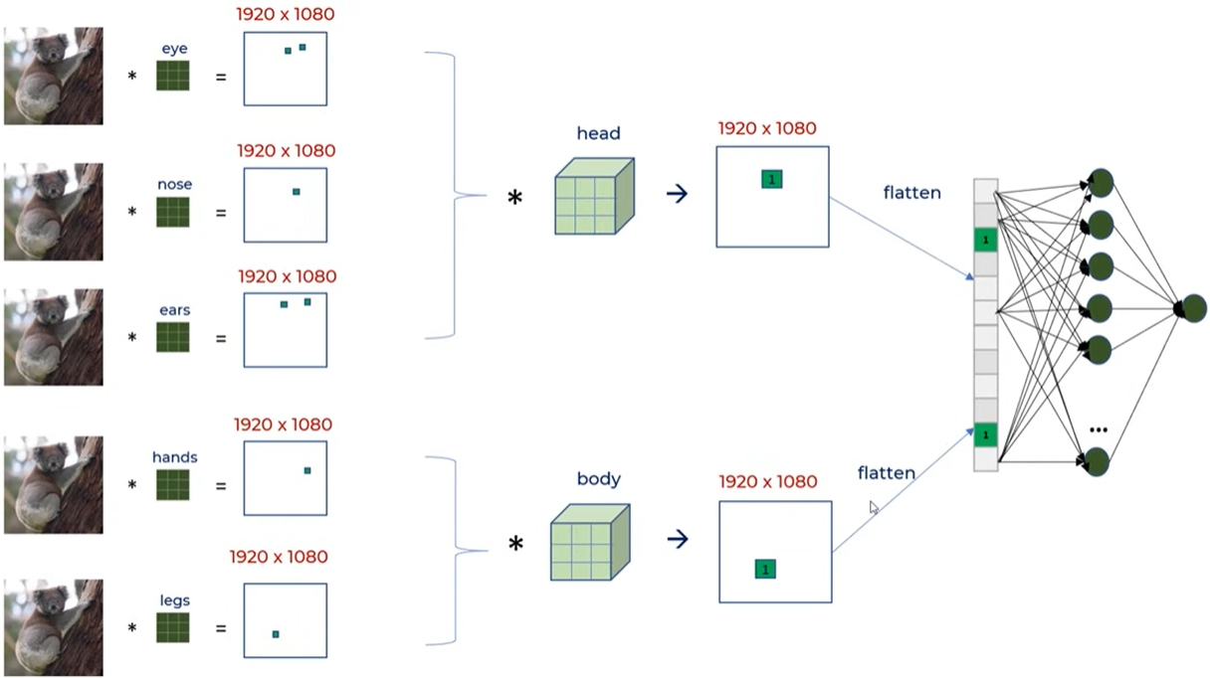
Problem in The Design
Our Convolution still outputs a 1920 x 1080 feature, which again causes high computation.

Slide 21
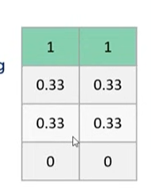
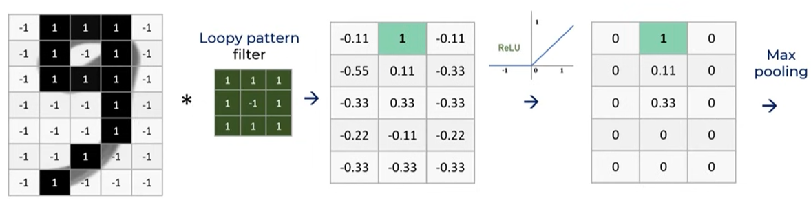
Pooling
A down sampling operation that reduces the spatial size of feature maps by summarizing nearby values. Reduces computation, controls overfitting, and keeps the most important features (e.g., max or average values known as max pooling and average pooling respectively.
Max Pooling of Stride 1

Slide 22
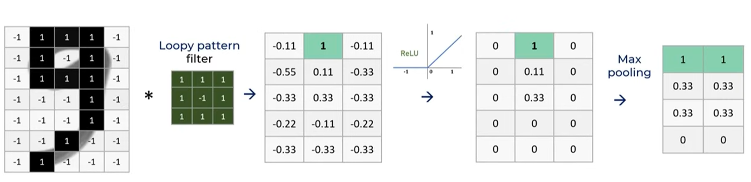
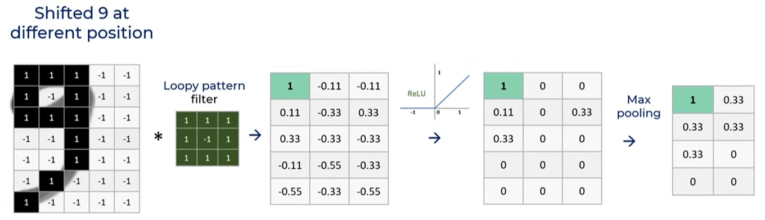
Pooling
Still getting the loopy pattern at top center in smaller feature map
Still getting the loopy pattern at top left in smaller feature map

Slide 23
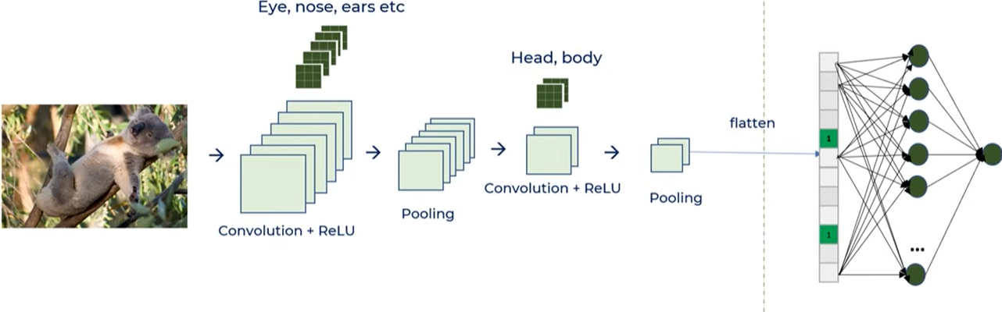
Putting them all together

Slide 24
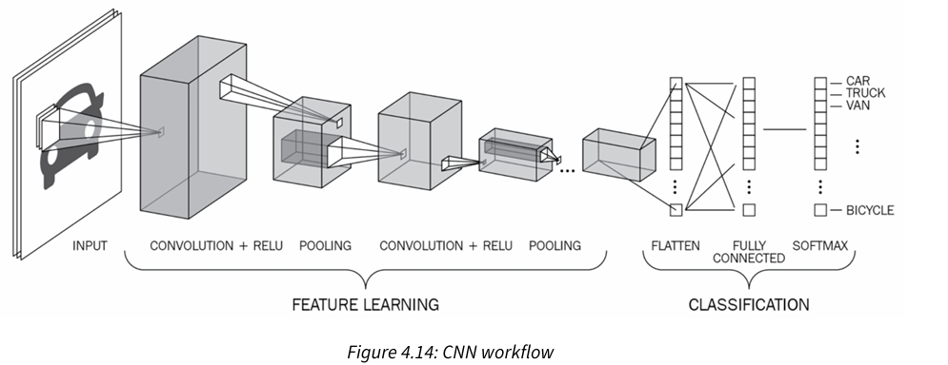
Putting them all together

Slide 25
Summarizing CNN
Convolution Layer: Applies filters to extract local features (edges, textures, patterns).
Activation Function (ReLU): Introduces non-linearity to learn complex patterns.
Padding: Adds border pixels to preserve spatial dimensions.
Stride: Controls how much the filter moves across the image.
Pooling Layer (Max/Average): Reduces spatial size while retaining important features.
Flatten Layer: Converts feature maps into a 1D vector.
Fully Connected Layer: Combines features to make final predictions.
Output Layer (Softmax/Sigmoid): Produces classification probabilities.

Slide 26
https://poloclub.github.io/cnn-explainer/#article-convolution
Wang, Z. J., Turko, R., Shaikh, O., Park, H., Das, N., Hohman, F., ... & Chau, D. H. P. (2020). CNN explainer: learning convolutional neural networks with interactive visualization. IEEE Transactions on Visualization and Computer Graphics, 27(2), 1396-1406.

Slide 27
Acknowledgment
Some concepts and examples in this presentation were inspired by Codebasics.
https://codebasics.io/

